Slide 1
Web Development 1
Cascading Style Sheets 1

Slide 2
What is CSS
CSS stands for Cascading Style Sheets
Styles define how to display HTML elements
Styles were added to HTML 4.0 to solve a problem
External Style Sheets can save a lot of work
External Style Sheets are stored in CSS files

Slide 3
Why CSS was invented
HTML was never intended to contain tags for formatting a document.
HTML was intended to define the content of a document, like:
<h1>This is a heading</h1>
<p>This is a paragraph.</p>
When tags like <font>, and colour attributes were added to the HTML 3.2 specification, it started a nightmare for web developers. Development of large web sites, where fonts and colour information were added to every single page, became a long and expensive process.
To solve this problem, the World Wide Web Consortium (W3C) created CSS.
In HTML 4.0, all formatting could be removed from the HTML document, and stored in a separate CSS file

Slide 4
Why use CSS
CSS defines how XHTML elements are to be displayed.
Styles are normally saved in external .css files.
External style sheets enable you to change the appearance and layout of all the pages in a Web site, just by editing one single file!

Slide 5
CSS Syntax
The syntax for CSS is different than that of (X)HTML markup. It consists of a set of rules – each with 3 parts.
selector { property: value }
The selector is the (X)HTML element that you want to style. The property is the actual property title, and the value is the style you apply to that property.
h1 { color:red; }

Slide 6
CSS Syntax
Each selector can have multiple properties.
The property and value are separated with a colon and contained within curly brackets. Multiple properties are separated by a semi colon.
h1 { color:red; text-align:center; }
p { color:black; text-align:left; }

Slide 7
CSS Comments
/*This is a comment*/ p { text-align:center; /*This is another comment*/ color:black; font-family:arial; }

Slide 8
How to insert/link a Style Sheet
There are three ways of inserting a style sheet:
External style sheet
Internal style sheet
Inline style

Slide 9
Internal Style sheet
With this method each (X)HTML file contains the CSS code needed to style the page. Meaning that any changes you want to make to one page, will have to be made to all.
This method can be good if you need to style only one page, or if you want different pages to have varying styles.
This will not pass the XHTML Strict test – Only XHTML transitional

Slide 10
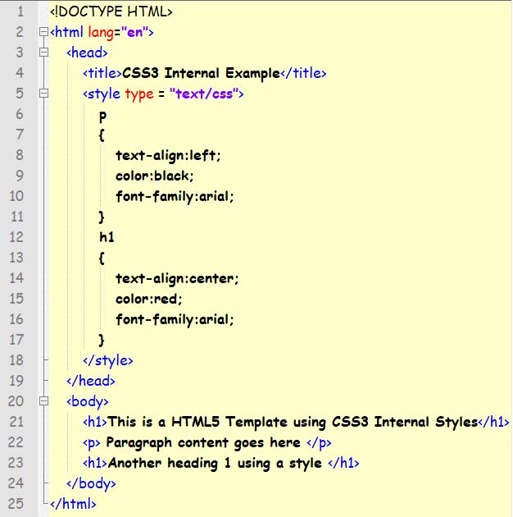
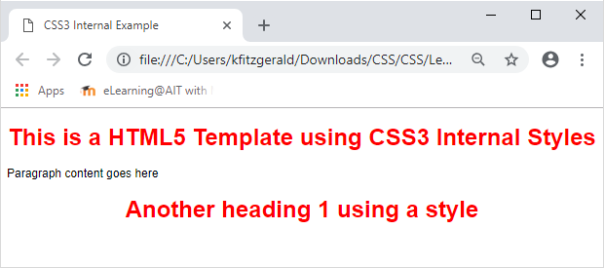

Slide 11
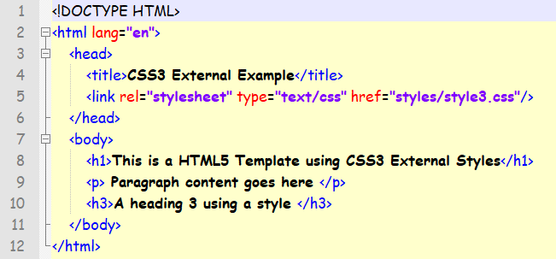
External Style Sheet
A CSS file contains no (X)HTML, only CSS. You simply save it with the .css file extension.
You can link to the file externally by using the element above in the head section of every (X)HTML file you want to style with the CSS file.

Slide 12
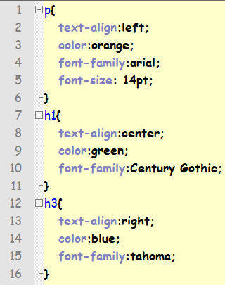
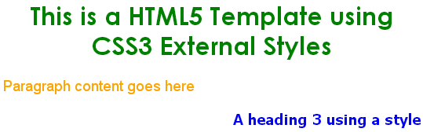

Slide 13
External Style Sheets
By using an external style sheet, all of your (X)HTML files link to one CSS file in order to style the pages. This means, that if you need to alter the design of all your pages, you only need to edit one .css file to make global changes to your entire website.
Why is this better?
Easier Maintenance
Reduced File Size
Improved Flexibility

Slide 14
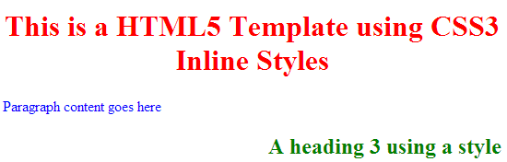
Inline Styles
An inline style loses many of the advantages of style sheets by mixing content with presentation. Use this method sparingly!
To use inline styles you use the style attribute in the relevant tag.
This will not pass the XHTML Strict test

Slide 15
Multiple Style Sheets
If some properties have been set for the same selector in different style sheets, the values will be inherited from the more specific style sheet.
All the various methods will cascade into a new "pseudo" style sheet in the following order:
Inline Style (inside (X)HTML element)
Internal Style Sheet (inside the <head> tag)
External Style Sheet

Slide 16
Background Colours
The background-color property specifies the background color of an element.
The background color of a page is defined in the body selector:
body {background-color:#b0c4de;}
With CSS, a color is most often specified by:
a HEX value - like "#ff0000"
an RGB value - like "rgb(255,0,0)"
a color name - like "red“
Link to colours: http://www.w3schools.com/cssref/css_colornames.asp

Slide 17
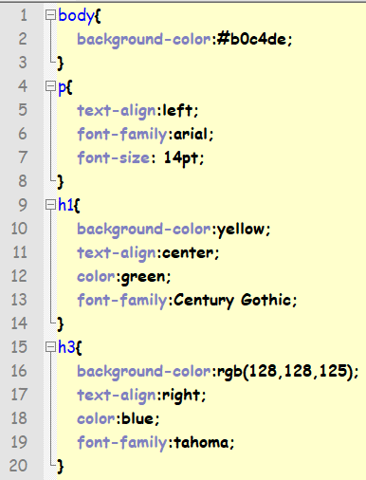
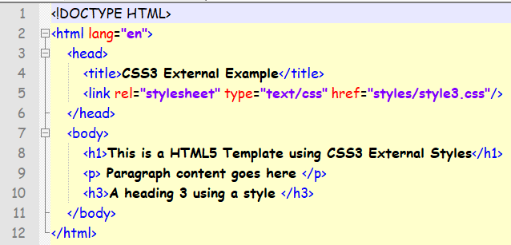
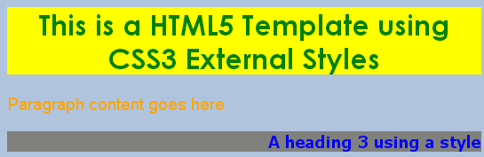

Slide 18
Background Image
The background-image property specifies an image to use as the background of an element.
By default, the image is repeated so it covers the entire element.
The background image for a page can be set like this:
body {background-image:url(‘background.gif');}

Slide 19
Background Position
You can position an image used for the background of an element using the background-position property.
Body{background-position: value;}
Values:
top left
top center
top right
center left
center center
center right
bottom left
bottom center
bottom right

Slide 20
Background Position
Value | Description
background-position: 2cm 2cm | The image is positioned 2 cm from the left and 2 cm down the page
background-position: 50% 25% | The image is centrally positioned and one fourth down the page
background-position: top right | The image is positioned in the top-right corner of the page

Slide 21
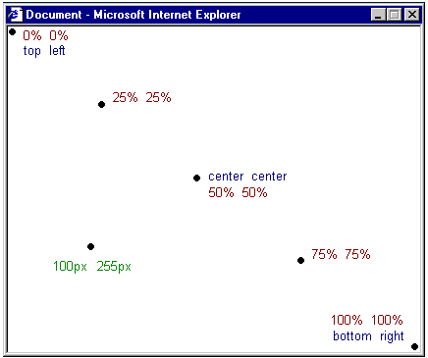
Background Position

Slide 22
Background Attachment
If you are using an image as a background, you can set whether the background scrolls with the page or is fixed when the user scrolls down the page with the background-attachment property
background-attachment: value;
Values:
fixed
scroll

Slide 23
Adding an image
body
{
background-image:url("engbld.jpg");
background-repeat:no-repeat;
background-position:top right;
}

Slide 24


Slide 25
Background Repeat
Value | Description
background-repeat: repeat-x | The image is repeated horizontally
background-repeat: repeat-y | The image is repeated vertically
background-repeat: repeat | The image is repeated both horizontally and vertically
background-repeat: no-repeat | The image is not repeated

Slide 26




Slide 27
Shorthand for background
background-color: #FFCC66;
background-image: url(“ait-icon.gif");
background-repeat: no-repeat;
background-attachment: fixed;
background-position: right bottom;
Can also be written as:
background: #FFCC66 url("butterfly.gif") no-repeat fixed right bottom;
[background-color] | [background-image] | [background-repeat] | [background-attachment] | [background-position]
If a property is left out, it will automatically be set to its default value.

Slide 28
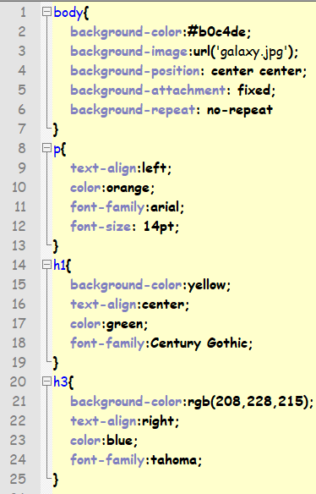
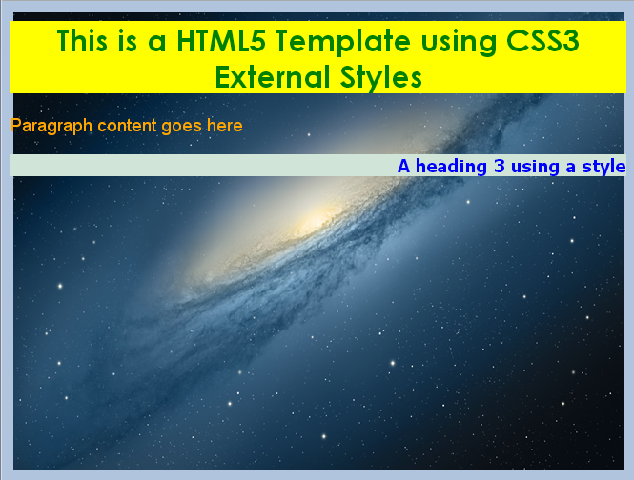

Slide 29
Inheritance
When you nest one element inside another, the nested element will inherit the properties assigned to the containing element - unless you modify the inner elements values independently.
For example, a font declared in the body will be inherited by all text in the file, unless you declare another font for a specific nested element.
body {font-family: Verdana, serif;}
Now all text within the (X)HTML file will be set to Verdana.

Slide 30
Inheritance contd..
If you wanted to style certain text with another font, like an h1 or a paragraph then you could do the following.
h1 {font-family: Georgia, sans-serif;} p {font-family: Tahoma, serif;}
Now all <h1> tags within the file will be set to Georgia and all <p> tags are set to Tahoma, leaving text within other elements unchanged from the body declaration of Verdana.

Slide 31
Combining Selectors
You can combine elements within one selector as follows:
h1, h2, h3, h4, h5, h6 { color: #009900; font-family: Georgia, sans-serif; }
All the header elements are grouped into one selector with each one separated by a comma.
The final result of the above code sets all headers to green and to the specified font.
If the user does not have the Georgia font, it will go to another sans-serif font the user has installed on their computer.

Slide 32
CSS Classes
The class selector allows you to style items within the same (X)HTML element differently, similar to inline styles, except that with classes the style can be overwritten by changing the style sheet.
You can use the same class selector again and again within an (X)HTML file.

Slide 33
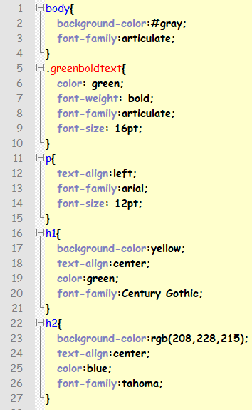
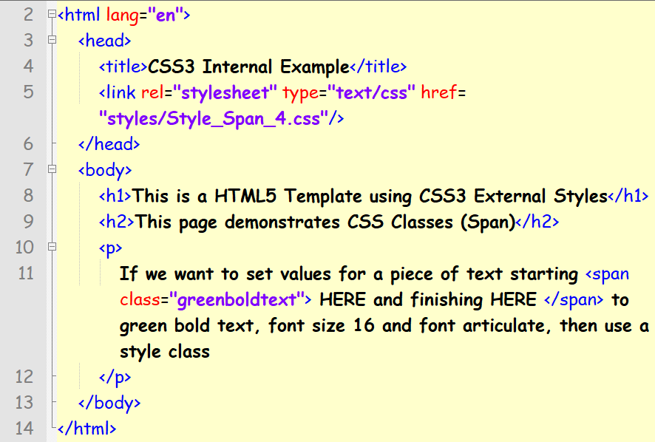
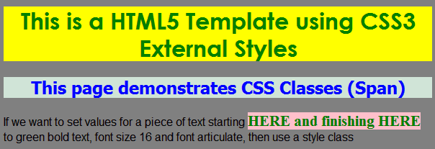

Slide 34
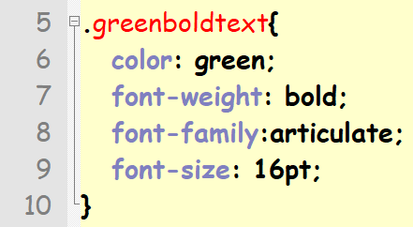
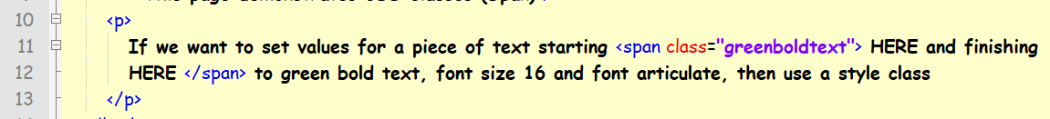
CSS Classes continued
Then in our CSS file we’d do this:
Notice that classes begin with a “.” in CSS.

Slide 35
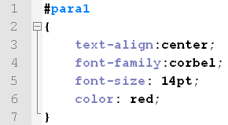
IDs in CSS
The id selector is used to specify a style for a single, unique element, unlike the class which can be used over and over.
The id selector uses the id attribute of the HTML element, and is defined with a "#".
eg

Slide 36
